Slide 1
Text Detection in Natural Scene Images
Ekansh Mahendru: 2018csb1087
Hansin Ahuja: 2018csb1094

Slide 2
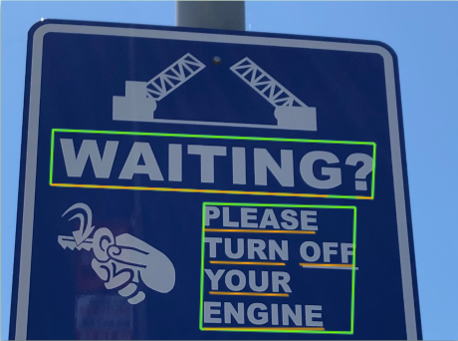

Problem Statement & Motivation
Scene text is text that appears in an image captured by a camera in an outdoor environment.
The detection and recognition of scene text from camera captured images are computer vision tasks which became important after smart phones with good cameras became ubiquitous. The text in scene images varies in shape, font, colour and position. The recognition of scene text is further complicated sometimes by non-uniform illumination and focus.
https://en.wikipedia.org/wiki/Scene_text

Slide 3
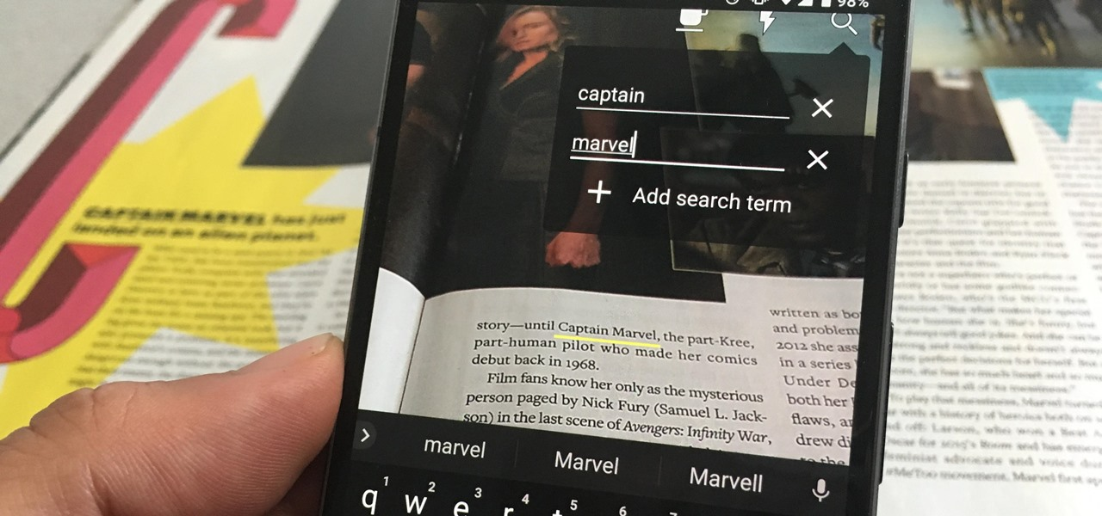
Problem Statement & Motivation
Automatic number plate recognition
In airports, for passport recognition and information extraction
More quickly make textual versions of printed documents, e.g. book scanning
Defeating CAPTCHA anti-bot systems, though these are specifically designed to prevent OCR. The purpose can also be to test the robustness of CAPTCHA anti-bot systems.
https://en.wikipedia.org/wiki/Scene_text

Slide 4
PixelLink:
Detecting Scene Text via Instance Segmentation
CRNN:
An End-to-End Trainable Neural Network for Image-Based Sequence Recognition & Its Application to Scene Text Recognition
Dan Deng, Haifeng Liu, Xuelong Li, Deng Cai
The Thirty-Second AAAI Conference
on Artificial Intelligence (AAAI-18)
Submitted: January, 2018
https://arxiv.org/abs/1801.01315
Baoguang Shi, Xiang Bai, Cong Yao
IEEE Transactions on Pattern Analysis & Machine Intelligence (Vol. 39 , Issue: 11)
Submitted : November, 2015
https://arxiv.org/abs/1507.05717

Slide 5
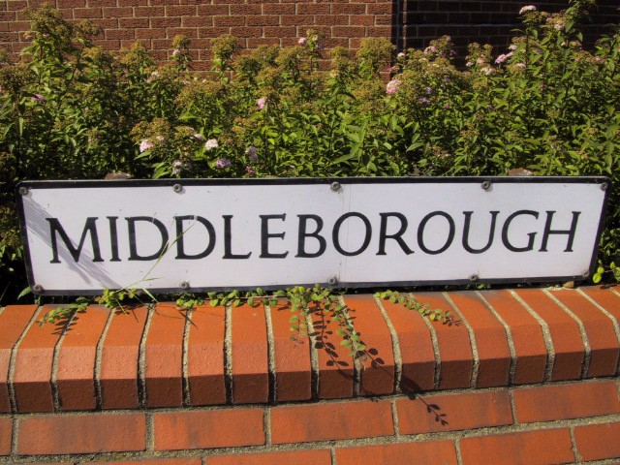
Input / Output Description
PixelLink
CRNN
“MIDDLEBOROUGH”

Slide 6
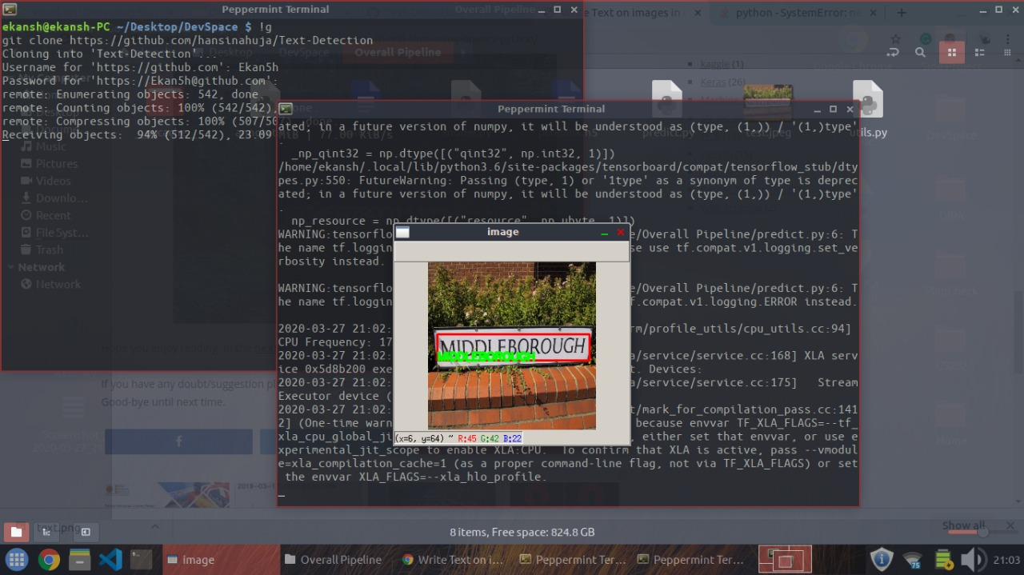
Input / Output Description
PixelLink
CRNN
“MIDDLEBOROUGH”
Input image
Bounding boxes
Cropped components
Predicted text
Final output

Slide 7
Standard datasets for this problem
MJSynth
COCO-Text
ICDAR2015
Synthetic Word Dataset (Oxford, VGG) - 2014
9 million images covering 90k English words
Synthetically generated dataset sufficient for training text recognition on real-world images
Computer Vision Group, Cornell - 2016
63,686 images, 173,589 text instances, 3 fine-grained text attributes
Based on the MSCOCO dataset.
Robust Reading Competition - 2015
Two sets: train and test, containing 1,000 and 500 images respectively
Only readable Latin scripts longer than 3 characters are cared

Slide 8
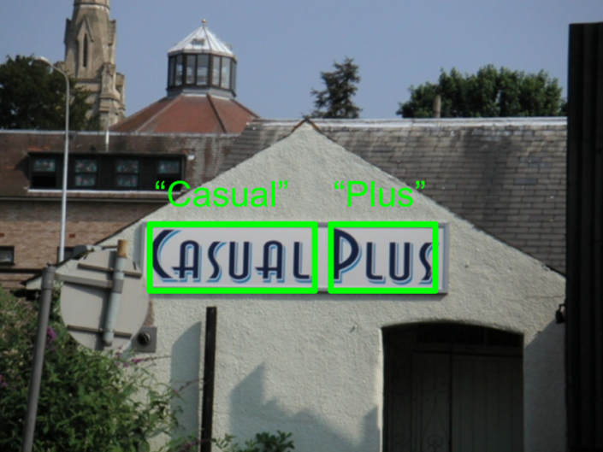
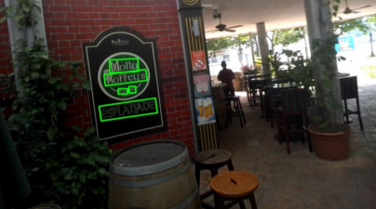
Standard datasets for this problem
MJSynth
COCO-Text
ICDAR2015
Synthetic Word Dataset (Oxford, VGG) - 2014
Computer Vision Group, Cornell - 2016
Robust Reading Competition - 2015

Slide 9
Approach Used

Slide 10

Text Based Image Segmentation - PixelLink
The first task in natural scene text recognition is to find out where the text is in the image. This task is known as Text Based Image Segmentation. The primary goal of this program would be to produce a mask for the input image where a true value or 1 signify that the pixel corresponds to some text. Also different instances of text should be labelled differently for correct recognition.

Slide 11
Solutions Preceding Neural Networks
Solutions before neural networks depended mainly on comparison with large number of instances of a given character. Some kind of enhancement is applied on the input image to make just the characters stand out. These characters are then separated and compared with the instances of each character to find the most similar one.
These methods were very limited due to the requirement of manual special enhancement and comparing with a large number of images made these methods too slow. Thus, such methods were only used in printed character recognition since the characters were consistent and were easily recognised with the white background.

Slide 12
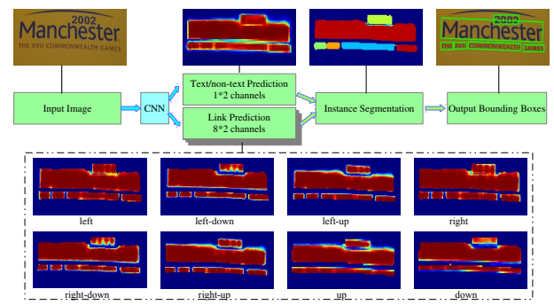
Proposed Solution
The paper proposes a convolutional neural network that produces both the text/non-text classification and links to the neighbors for each pixel of the image. For a text pixel, the link matrix will specify whether it and its neighbors are part of the same text instance or not. This solves the problem of identifying overlapping text instances in the image.

Slide 13
Neural Networks
Convolutional Neural Networks
Max Pooling
A neural network is a series of algorithms that endeavors to recognize underlying relationships in a set of data through a process that mimics the way the human brain operates.
A Convolutional Neural Network (ConvNet/CNN) is a Deep Learning algorithm which can take in an input image, assign importance (learnable weights and biases) to various aspects/objects in the image and be able to differentiate one from the other.
Maximum pooling, or max pooling, is a pooling operation that calculates the maximum, or largest, value in each patch of each feature map.

Slide 14
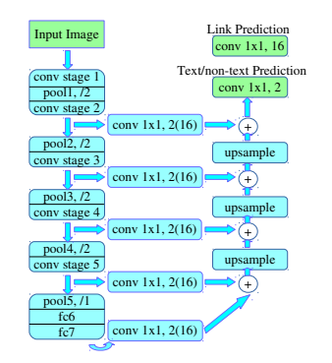
Network Architecture
Structure of PixelLink+VGG16 2s
fc6 and fc7 are converted into convolutional layers. The upsampling operation is done through bilinear interpolation directly. Feature maps from different stages are fused through a cascade of upsampling and add operations. All pooling layers except pool5 take a stride of 2, and pool5 takes 1. Therefore, the size of fc7 is the same as conv5 3, and no upsampling is needed when adding scores from these two layers. ‘conv 1 × 1,2(16)’ stands for a 1×1 convolutional layer with 2 or 16 kernels, for text/non-text prediction or link prediction individually.
VGG16

Slide 15
The Loss Function
The total loss is defined as: L = 𝝀L_{pixel} + L_{link} (𝝀 is taken to be 2)
The pixel loss is defined on all positive pixels and some negative pixels selected through OHEM(explained in next slide) as a weighted Cross Entropy loss. Cross entropy for two classes is given as:
L_{CE}(t,o) = -t log(o) - (1-t) log(1-o) Here, t is true value and o is output
Since t can only be 0 or 1, only one log term becomes the loss. Thus, this is also known as log loss. The loss function is minimum when (t = o = 0 or 1).
The link loss is also a weighted cross entropy loss counted only for positive pixels.
The weight in both these losses is dependent on how big the text instance for each pixel is. This ensures equal weightage to smaller and bigger instances of text and removes any bias.

Slide 16
OHEM (Online Hard Example Mining)
One class classification is a difficult task because of large number of possibilities in the negative class. To solve this problem OHEM is used. It is basically a method to include only examples with very high loss in the negative class. This can be done after each epoch but that would be very computationally intensive. Hence, it is done in an online manner while computing the loss itself.
OHEM is very important to the network for the given task. If the network is trained without OHEM and including all negative examples, it minimises the loss by outputting all pixels as non-text (local-minima) (can be seen in train.ipynb, the model is stuck in the local minima) since most of the pixels in image are non-text.

Slide 17
Post-Processing
The text/non-text classification alone is not sufficient enough to produce a segmentation mask as many non-text pixels are identified as text pixels but the linkage to neighbors helps to filter out the non-text areas. As a post-processing step, each text instance is separated out in the image (two text pixels connected through some linkage are considered to be of the same instance). Then all these are filtered by using their geometry ie height, width, aspect ratio etc. This step removes most of the noise and produces accurate output. The choice of threshold depends on the application but the paper uses 99th percentile of the training dataset. As a final step, bounding boxes are found for each instance.

Slide 18
Evaluation Metrics: Recall, Precision and F-Score
Recall: It signifies how many of the positive cases were classified positive by the network.
Precision: It signifies how many of the cases classified positive by the network were really positive.
Both these measures differ very slightly in meaning but together are a powerful measure of the accuracy of segmentation networks. Thus, F-score is used to compare different models.
F-Score: It is the harmonic mean of recall and precision.

Slide 19
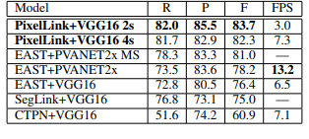
Comparison with other State of the Art models
PixelLink performance in comparison with other methods on ICDAR15 dataset
It can be seen how only PixelLink increases accuracy than EAST at the cost of speed.

Slide 20
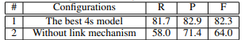
Importance of Post Processing
One could argue, why produce a link matrix if we directly get the text/non-text classification from the neural network? But this link matrix along with the post processing steps is what makes this method accurate even for non-overlapping texts.
The significant drop in scores is evidence of the importance of the post processing mechanism.

Slide 21
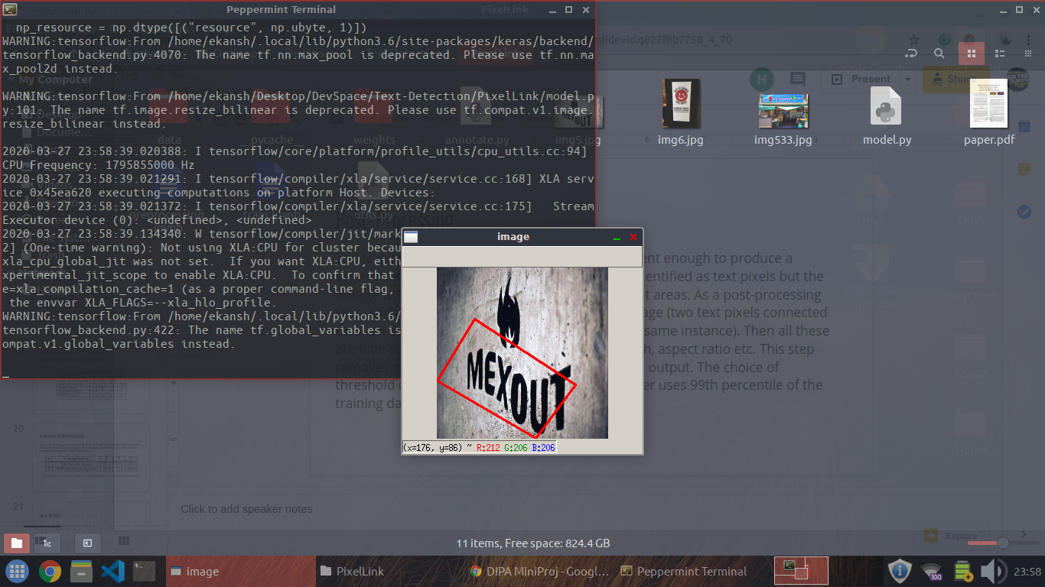
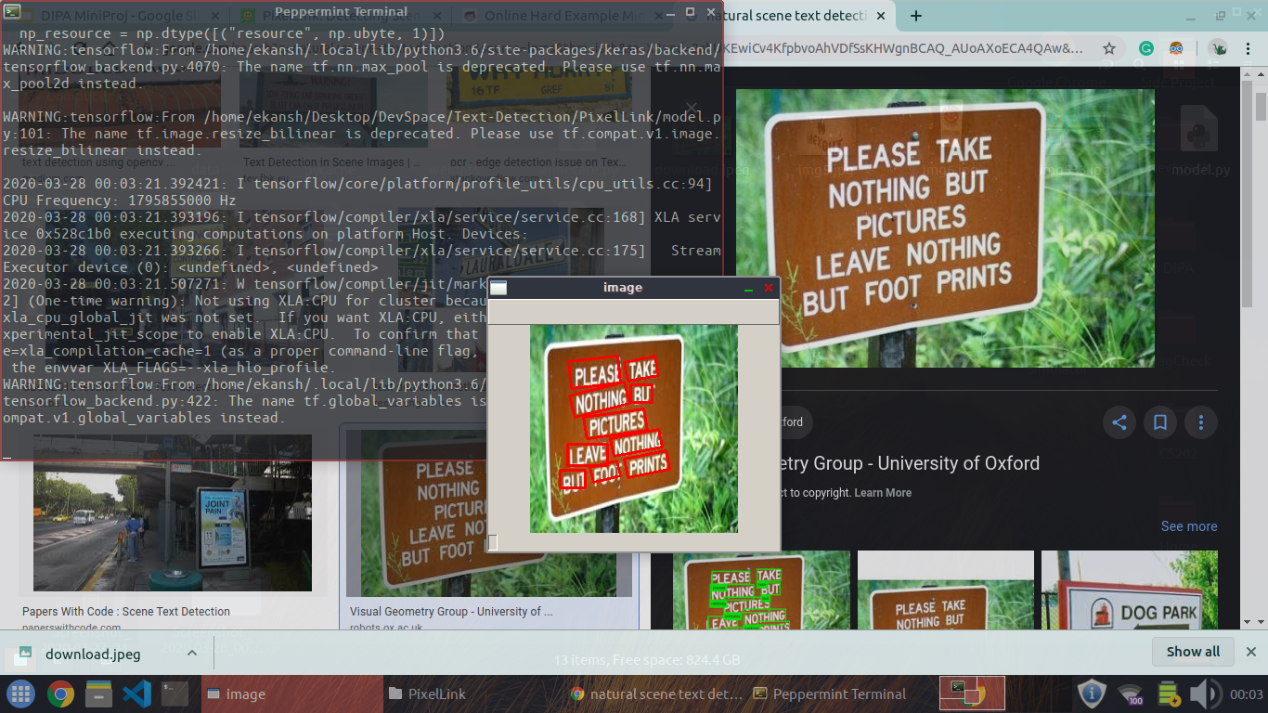
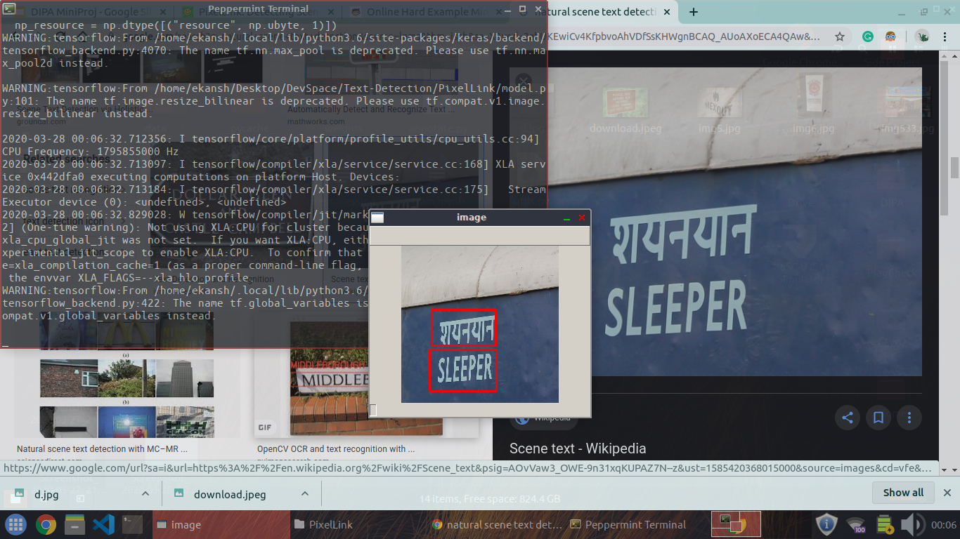
Some Results
Long sentences (Overlapping Masks)
Different Script
Curved text (T is not fully recognised)

Slide 22
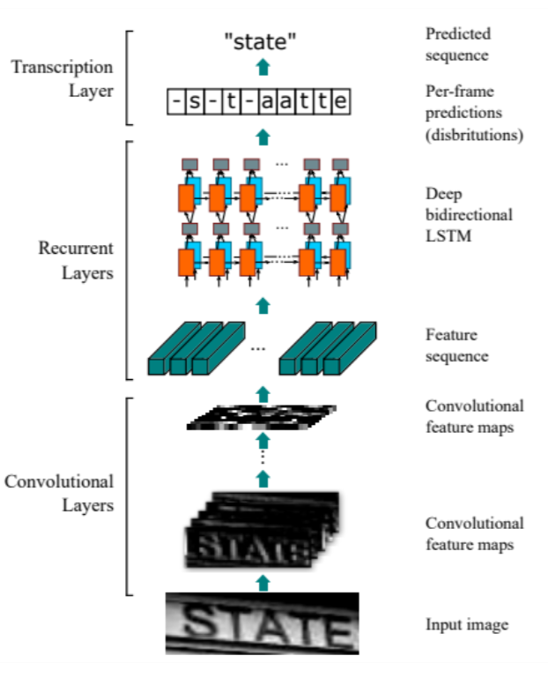
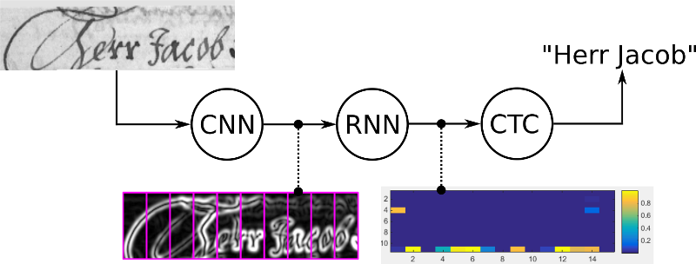
Text Recognition - CRNN (CNN + RNN)
https://towardsdatascience.com/a-gentle-introduction-to-ocr-ee1469a201aa
https://towardsdatascience.com/intuitively-understanding-connectionist-temporal-classification-3797e43a86c

Slide 23
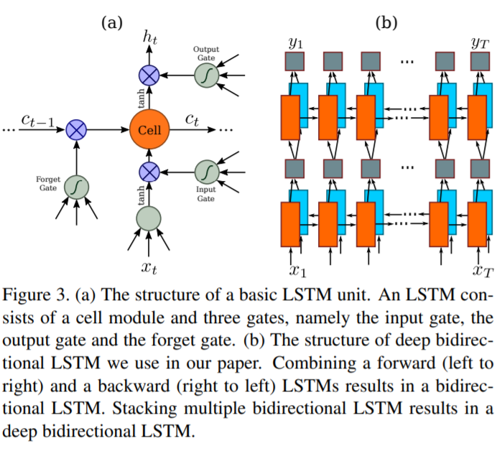
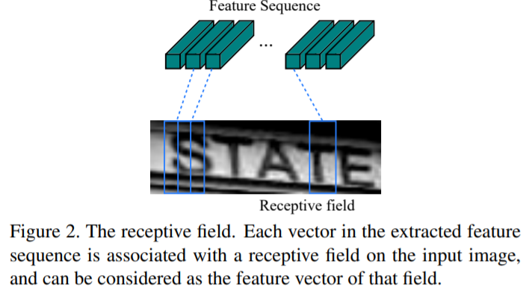
Text Recognition - CRNN (CNN + RNN)
https://arxiv.org/pdf/1507.05717.pdf

Slide 24
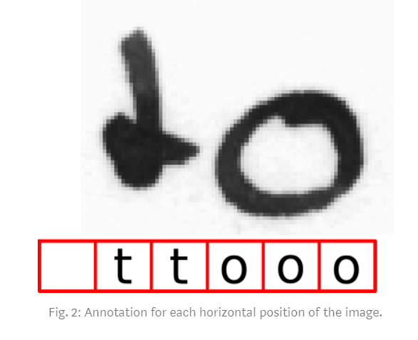
Encoding the Text
Introducing a pseudo-character, blank (-)
Three rules:
We can insert arbitrary many blanks at any position
We must insert a blank between duplicate characters, eg, too
We can repeat each character as often as we like.
Example:
“to”
---ttttttooo
-t-o-
to
“too”:
---ttttto-o
-t-o-o-
to-o
NOT “too”

Slide 25
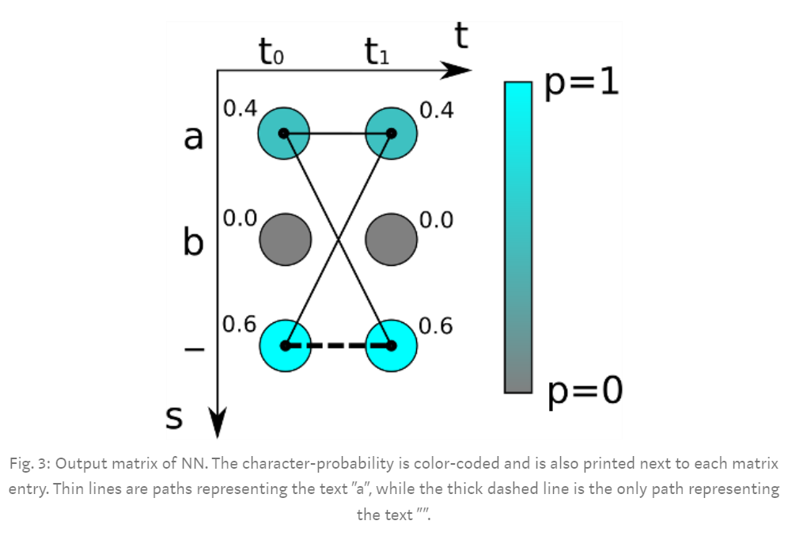
Calculating the CTC Loss
It tries all possible alignments of the ground truth text in the image and takes the sum of all scores. This way, the score of a ground truth text is high if the sum over the alignment-scores has a high value.
If the ground truth is “a”:
Path 1: “aa” -> 0.4*0.4
Path 2: “a-” -> 0.4*0.6
Path 3: “-a” -> 0.6*0.4
Total score = 0.64
If the ground truth is “”:
Path 1: “--” -> 0.6*0.6
Total score = 0.36
Loss = negative log of the total score

Slide 26
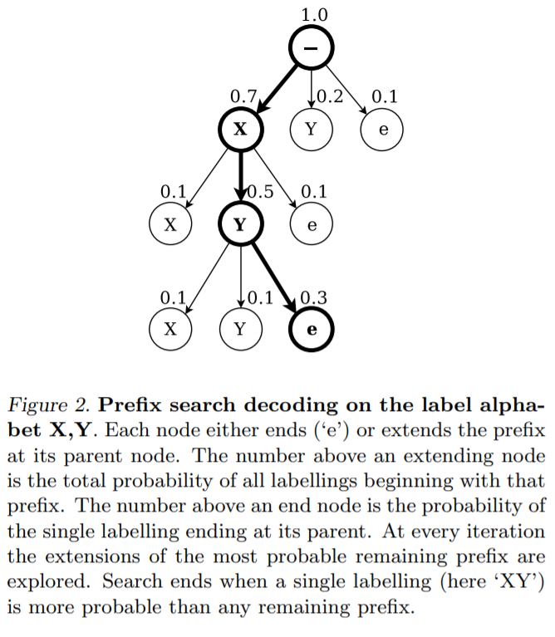
Decoding the Text
Best path decoding:
Calculate the best path by taking the most likely character per time-step.
Decode by first removing duplicate characters and then removing all blanks from the path. What remains represents the recognized text.
Only an approximation
The approximation algorithm often gives good results in practical situations.
Advanced decoders: beam-search decoding, prefix-search decoding or token passing, which also use information about language structure to improve the results.
https://www.cs.toronto.edu/~graves/icml_2006.pdf

Slide 27
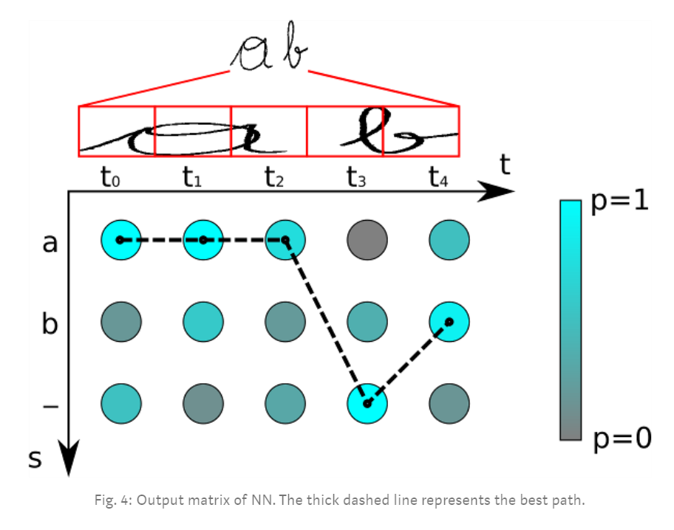
Decoding the Text
Most likely character at:
t0 : a
t1 : a
t2 : a
t3 : -
t4 : b
Best path: “aaa-b”
Remove duplicates: “a-b”
Remove blanks: “ab”
Output: “ab”

Slide 28
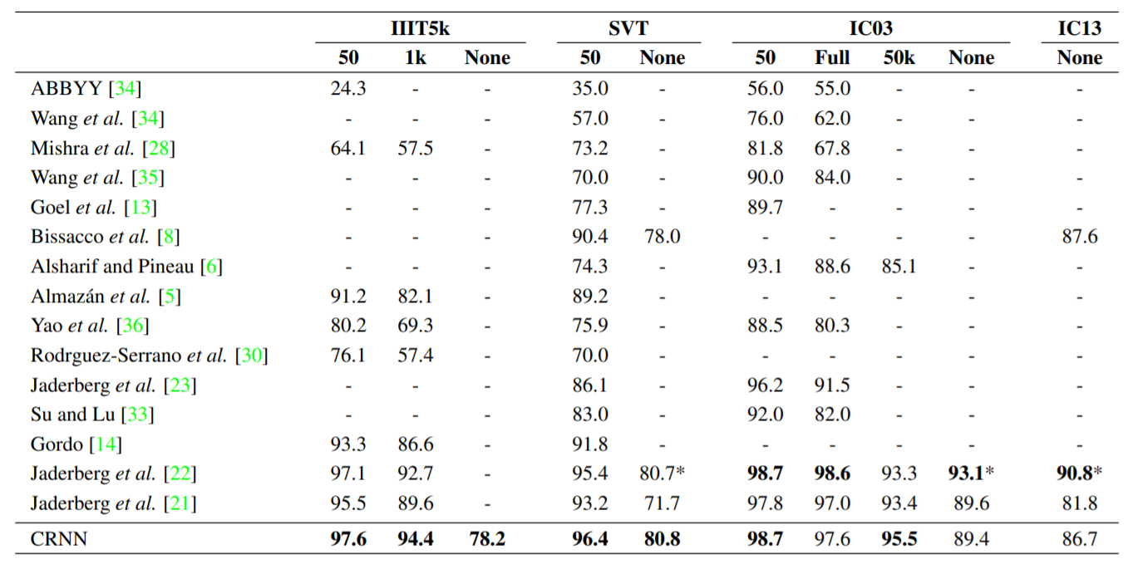
Results for the CRNN
Evaluation criteria is accuracy (Correct predictions / Total number of queries)

Slide 29
Results for the CRNN
Evaluation criteria is accuracy (Correct predictions / Total number of queries)
Dataset | IIIT5K | 3000 images
Author’s accuracy | 78.2% | Trained on 9 million images
Our accuracy | 70.6% | Trained on 100k images

Slide 30
Our results for the CRNN
GOOD PREDICTIONS
OKAY PREDICTIONS
BAD PREDICTIONS
Ground truth: Brownsville
Prediction: Brownsville
Ground truth: YIELDS
Prediction: VIELDS
Ground truth: BOUILLON
Prediction: Bs
Ground truth: LOADERS
Prediction: LOADERS
Ground truth: masseuses
Prediction: masscuses
Ground truth: ethane
Prediction: ctlac
Ground truth: Secretariats
Prediction: Secretariats
Ground truth: wuss
Prediction: Wuss
Ground truth: DISCIPLINE
Prediction: GSLOPAANE

Slide 31
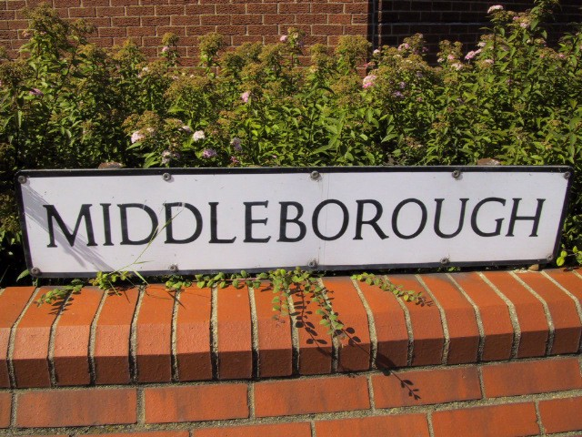
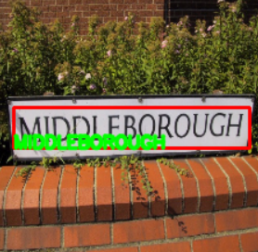
Final output

Slide 32
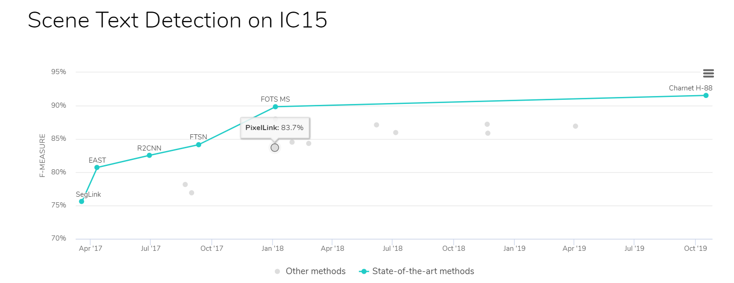
Some other methods
https://paperswithcode.com/sota/scene-text-detection-on-ic15

Slide 33
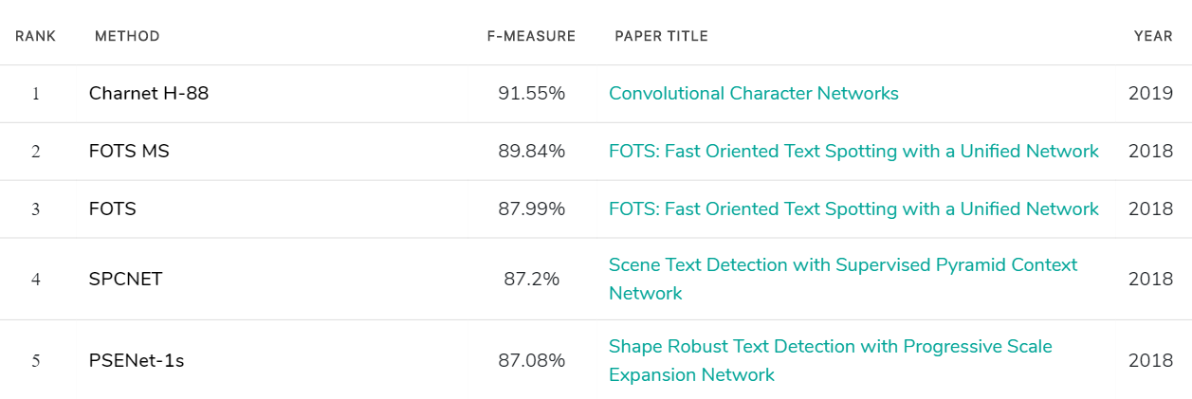
Some other methods

Slide 34
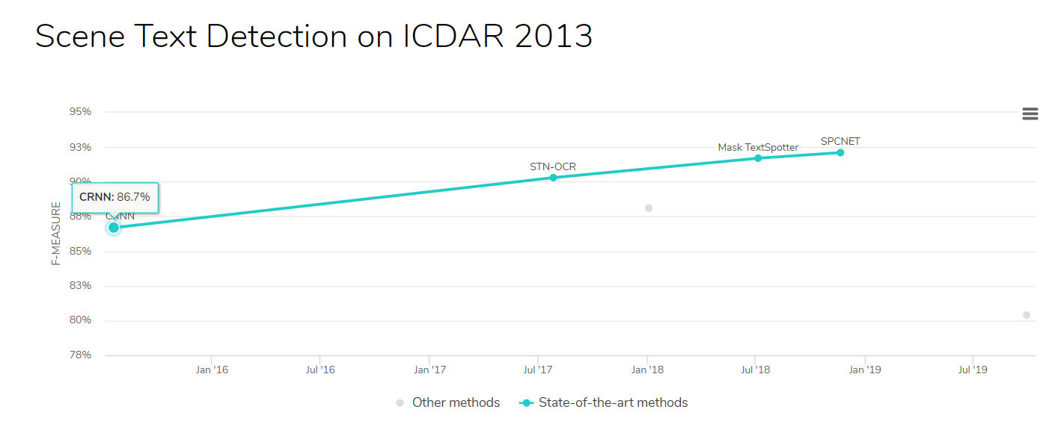
Some other methods
https://paperswithcode.com/sota/scene-text-detection-on-icdar-2013

Slide 35
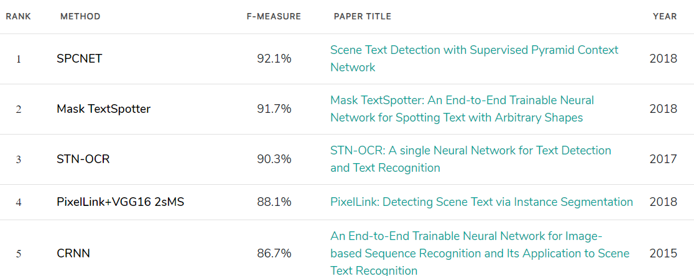
Some other methods

Slide 36
Our Learnings
Convolutional Neural Networks are very effective in tasks pertaining to images due to their ability to identify spatial and temporal dependencies and their translation invariant property ie CNNs will not be affected if the input is shifted.
Recurrent Neural Networks are very effective in tasks pertaining to texts due to their ability to identify the relationship of current data to previous data (or next data if bidirectional).
An RNN is trained to recognize patterns across time, while a CNN learns to recognize patterns across space. ^{[1]}

